Slide 1


FLYNFO
FLY WITH INFORMATION.

Slide 2
BUSINESS PROPOSAL
FLYNFO is a comprehensive solution aimed at efficiently managing and optimizing various aspects of the aviation industry. This system encompasses a wide range of functionalities, including airplane management, route planning, flight scheduling, fare management, passenger data, employee information, financial transactions, country data, and airport information.
The primary objectives of the FLYNFO Airplane Management System are as follows:
1.Operational Efficiency: Streamline and automate aviation management processes, such as route and flight planning, fare management, and resource allocation.
2. Enhanced Customer Experiences: Improve the passenger experience through easy booking, personalized services, and real-time flight information.
3. Resource Optimization: Optimize the utilization of airplanes and employees to achieve cost savings and operational efficiency.
4. Data Security: Ensure robust data security measures to safeguard sensitive passenger and employee information.

Slide 3

PROBLEM STATEMENT
Travel planning especially through airways are complex processes and very time-consuming, Passengers often face challenges such as:
Difficulty in modifying or cancelling bookings.
Requirement of unnecessary information while flight ticket booking.
Lack of information provided on the details regarding fare prices and hidden charges like tax, insurance, etc.
Glitches or chances of failed transactions during booking of flight.

Slide 4

PROPOSED SOLUTION
We have produced a solution which is a website called “FLYNFO: FLY WITH INFO”. This will provide a centralized platform for managing all the airport and flight information. This website aims to simplify the flight booking process and it also provides passengers with a convenient and easy to understand platform for searching, booking and managing their flight tickets. Travelers can easily search for flights based on their departure airport and arrival airport and further can book flights directly through the website. . A transparent fare prizing system has been developed which displays all the hidden charges, providing utmost clarity to the user.

Slide 5

USERS
The Flight Booking Website will serve the following user groups:
Travelers: Individuals, families, and business travelers looking to book flights for their trips.
Travel Agencies: Partnerships with travel agencies to offer flight booking services through the platform.
Airlines: Collaboration with airlines to list their flights on the platform.

Slide 6
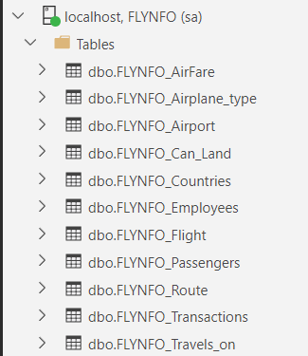
DATABASE-FLYNFO

Slide 7
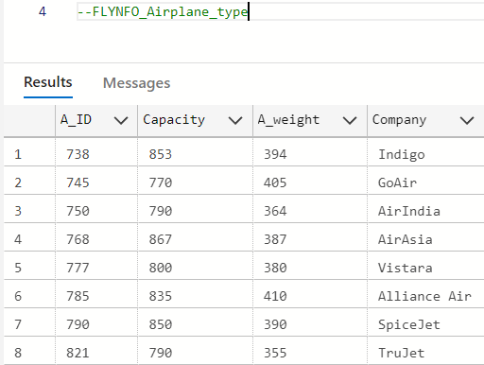
ATTRIBUTES
FLYNFO_AIRPLANE_TYPE
CREATE TABLE Airplane_type
(A_ID INT,
Capacity INT,
A_weight INT,
Company VARCHAR(15),PRIMARY KEY(A_ID));

Slide 8
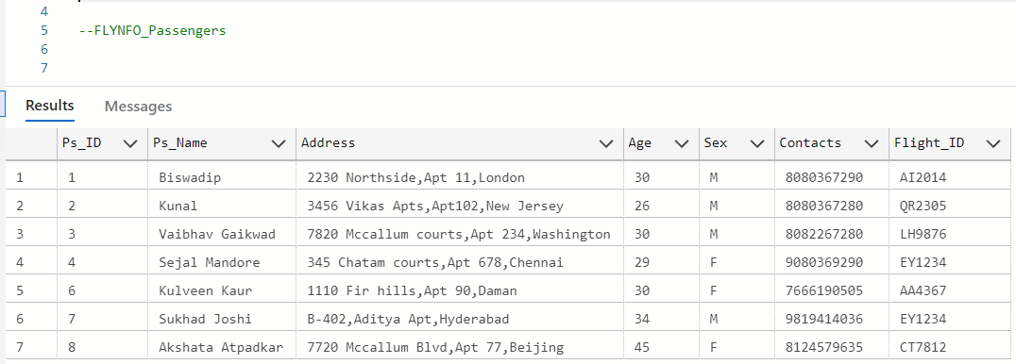
ATTRIBUTES
FLYNFO_PASSENGERS
CREATE TABLE Passengers
(Ps_ID INT, Ps_Name VARCHAR(20), Address VARCHAR(50), Age INT, Sex VARCHAR(1),
Contacts VARCHAR(10), Flight_ID VARCHAR(15), PRIMARY KEY(Ps_ID),
FOREIGN KEY (Flight_ID) REFERENCES Flight(Flight_ID));

Slide 9
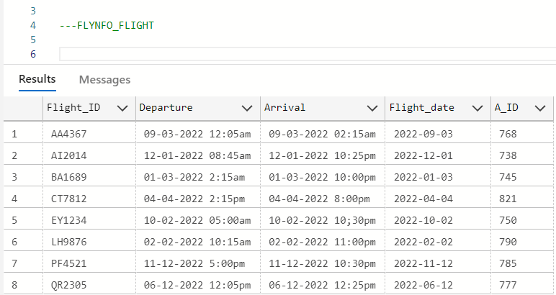
ATTRIBUTES
FLYNFO_Flight
(
Flight_ID VARCHAR(15), Departure VARCHAR(30), Arrival VARCHAR(30), Flight_date DATE, A_ID INT, PRIMARY KEY(Flight_ID), FOREIGN KEY (A_ID) REFERENCES Airplane_type(A_ID)
);

Slide 10
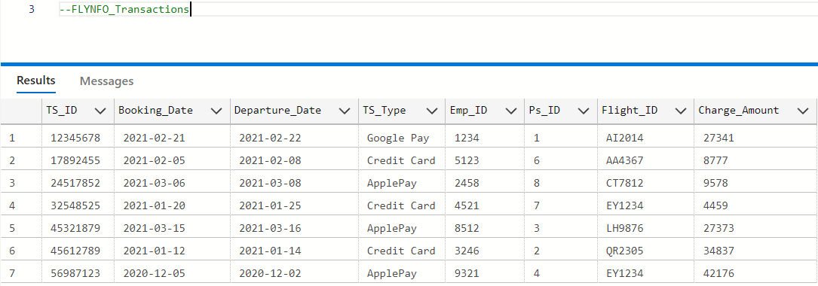
ATTRIBUTES
FLYNFO_TRANSACTIONS
FLYNFO_TRANSACTIONS
CREATE TABLE Transactions
(
TS_ID INT,
Booking_Date DATE,
Departure_Date DATE,
TS_Type VARCHAR(20),
Emp_ID INT,
Ps_ID INT,
Flight_ID VARCHAR(15),
Charge_Amount INT,
PRIMARY KEY(TS_ID),
FOREIGN KEY (Emp_ID) REFERENCES Employees(Emp_ID) ,
FOREIGN KEY (Ps_ID) REFERENCES Passengers(Ps_ID),
FOREIGN KEY (Flight_ID) REFERENCES Flight(Flight_ID),
FOREIGN KEY (Charge_Amount) REFERENCES AirFare(Fare_ID)
);

Slide 11
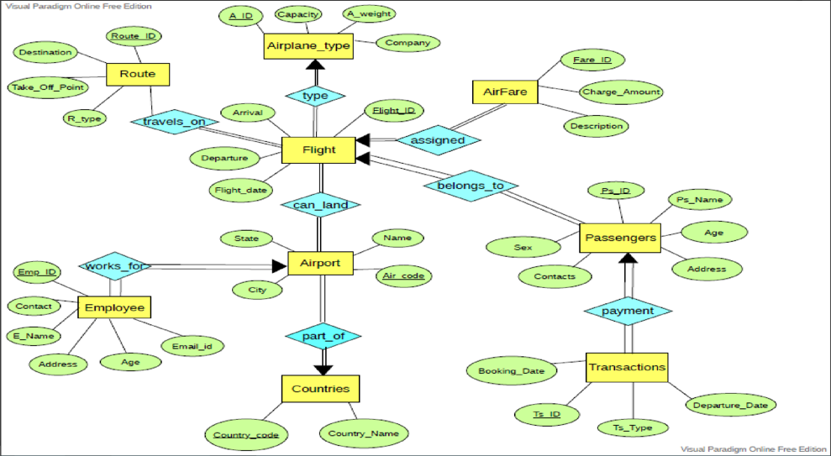
ENTITY RELATIONSHIP DIAGRAM

Slide 12
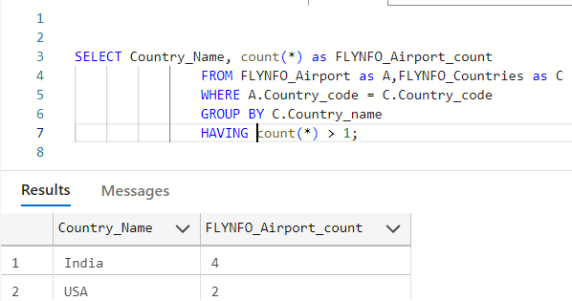
Find all country name with more than one airport.

Slide 13
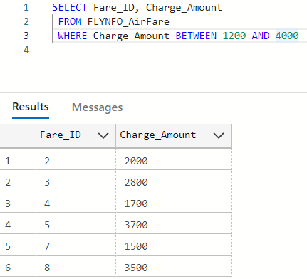
Find the Fare-id of those with Charge-amount between 1400 and 4000.

Slide 14
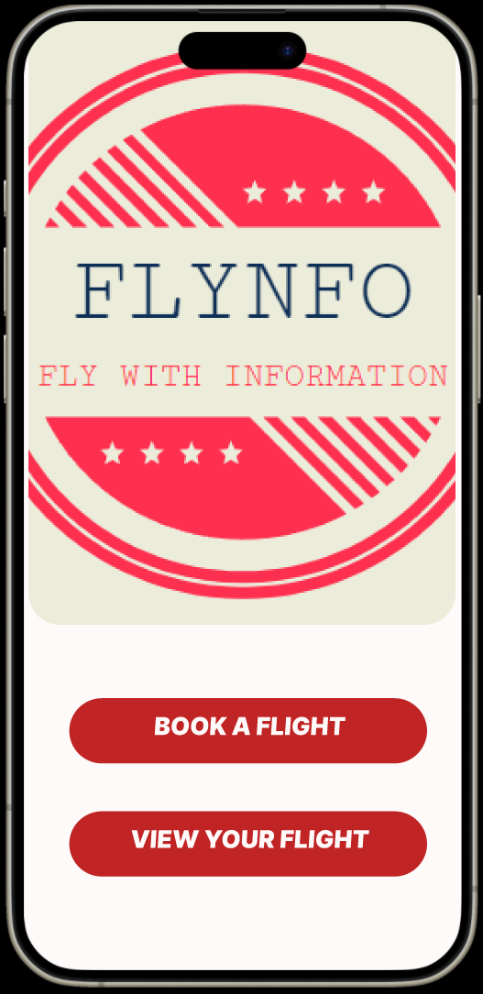
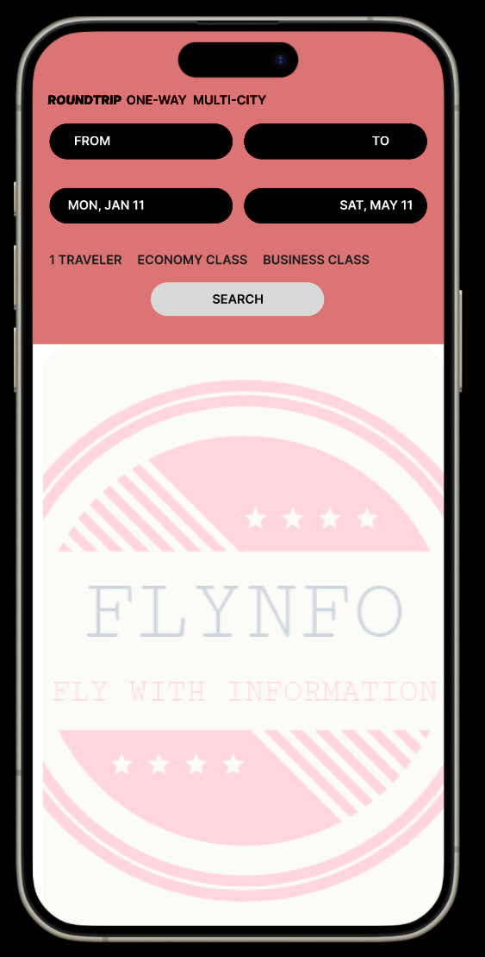
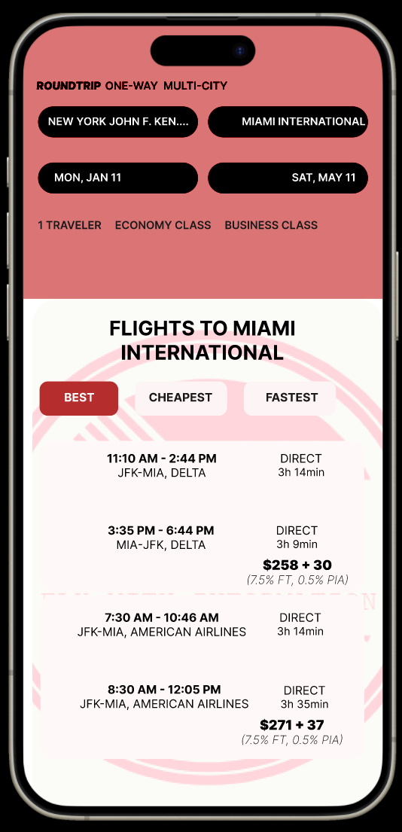
OUTPUTS

Slide 15
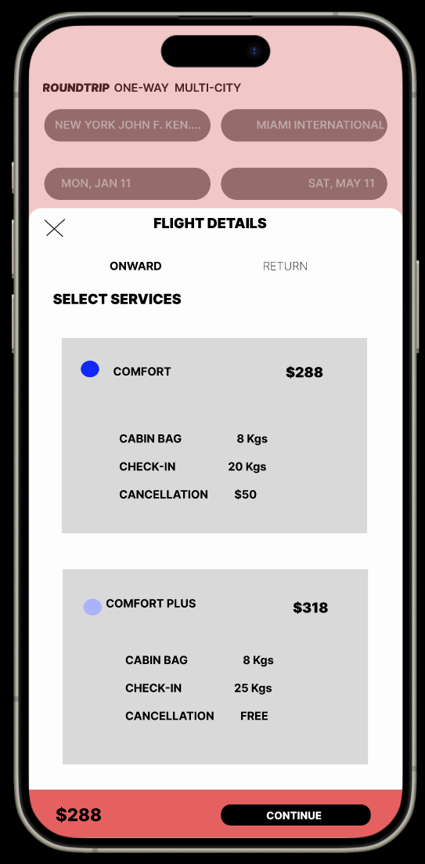
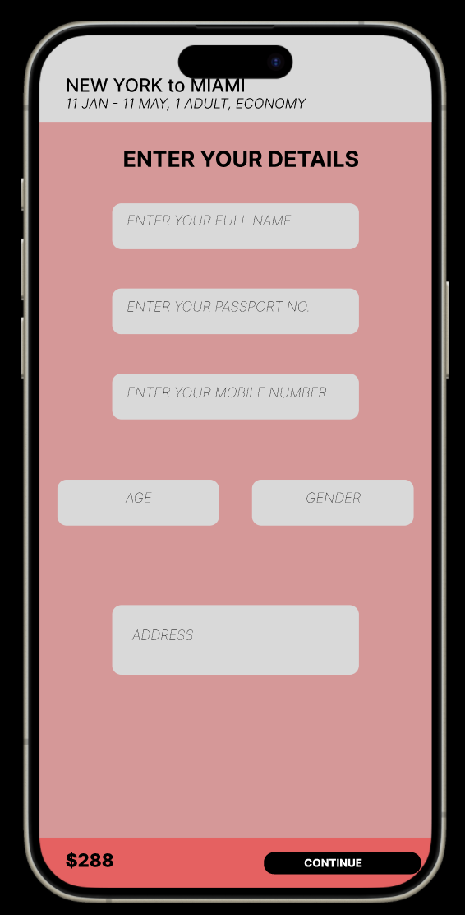
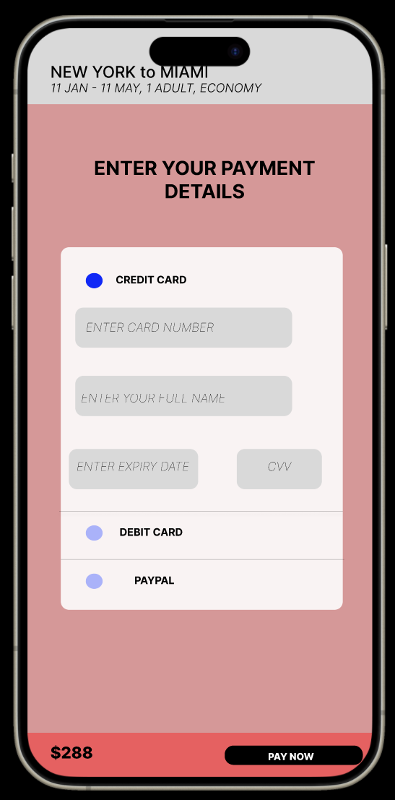
OUTPUTS

Slide 16

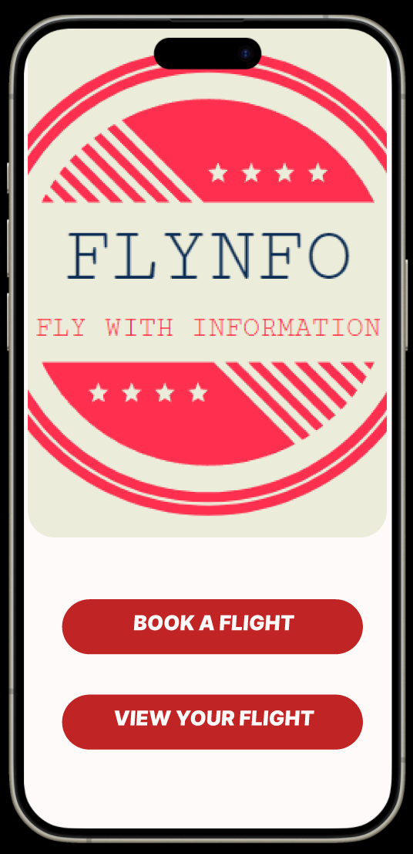
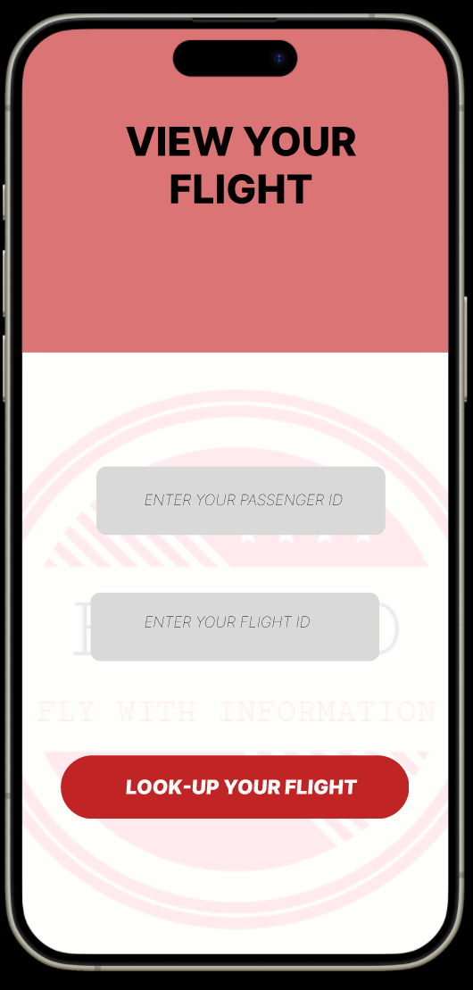
OUTPUTS

Slide 17

FLY SAFE!
MIHIR NILESH HOLMUKHE
VAIBHAV VIKAS GAIKWAD
SUKHAD DNYANESH JOSHI
BISWADIP BISWANATH BHATTACHARYYA

